Slide 1
Data Visualization and Data Optimization Using Orange
Dr. Amit Kamra,
Guru Nanak Dev Engineering College, Ludhiana

Slide 2
Introduction
Almost every area of research require visualization and optimization of data.
Certain tools can bring out difficulty from doing the above task and make it fun.
Not everyone is willing to learn coding.
This is where GUI based tools can come in handy.

Slide 3
Today, I will introduce you to another GUI based tool – Orange.
Orange is an open source data visualization and analysis tool, where data mining is done through Python scripting.
But we are not going to learn Python coding today.

Slide 4
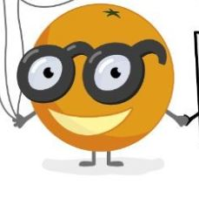
ORANGE
Word "Orange" gives a first impression that it is a fruit, which is a very obvious thing.
I am talking of Orange which is an open source tool.
Tool has components for Image Processing, machine learning, bioinformatics and text mining and it is packed with features for data analytics.
Tool is great for beginners who wish to visualize patterns and optimize them without really knowing how to code.

Slide 5
What is Orange ?
Orange is an open source component-based visual programming software package
Used for
Data Visualization,
Image Processing,
Bioinformatics,
Machine Learning,
Data Mining,
Data Analysis
Components of Orange are called Widgets

Slide 6
Widgets range from
Simple Data Visualization,
Subset Selection,
Pre-processing,
Practical evaluation of learning algorithms
Predictive Modeling.
We will be doing all the above things today
Visual programming is implemented through an interface in which, workflows are created by linking predefined or user-designed widgets

Slide 7
Open source
Best part of Orange
Tool is undoubtedly a boon for people doing PhD or Masters in most of areas of Computer Science and information technology.
One can modify the algorithm as per your application.
You can add that modified algorithm in Orange and take the results.

Slide 8
Visual Programming
Tool is not just meant for computer science professionals but even for other fields user as it provides visual programming.
As simple installing a game and then playing it.
No need to learn any kind of programming languages.
Only thing which you should know is Image Processing/Bio-informatics/Machine Learning/data mining concepts/as widgets are corresponding to each domain.
You should know that which algorithm or widget should be used in a particular scenario.

Slide 9
Smart Tool
You will definitely fall in love with this tool when you will experience its flexible and visual environment.
It provides dotted lines if connection is not proper.
If you are not using proper algorithm or doing something wrong then it will not allow you to connect with the data.

Slide 10
Installation Steps for Orange
Step 1: Download and install Orange
You can download latest version of orange from following link: https://orange.biolab.si/download/
Step 2: Run the installer
Step 3: After installing you will get Orange icon on your desktop and click on it and open the Orange tool.
Step4: You will be prompted with a welcome screen of Orange. Now you are ready to start with your first project.
But You need to check windows version, Whether it is 32 bit or 64 bit
Orange3-3.27.1-Miniconda-x86_64.exe (64bit)

Slide 11
Add-ons to extend the functionality
Possible to extend the functionality of Orange through add-ons which are available online.
In fact, Orange never provides the toolbox for image analytics and bioinformatics data as an integral part of it;
Rather than it has always been an add-on.
Unfortunately there are some negative side effects of this process,
Notably the temporary breakage of the add-on management dialog within the Orange Canvas.
It is reported that this is now being taken care of and you are encouraged to test the functionality.

Slide 12
Additional Widgets
When you install additional widgets, you may or may not get some error
Sometimes you need to install LIBBZ2.dll file
Copy this file in windows directory
Then additional widgets will start working and will be displayed in widget menu.
If OS is fully updated, then orange additional widgets may be installed readily.

Slide 13
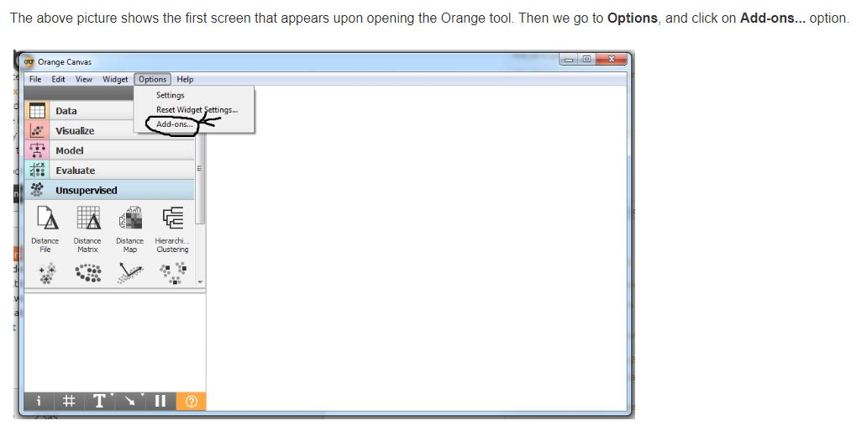

Slide 14
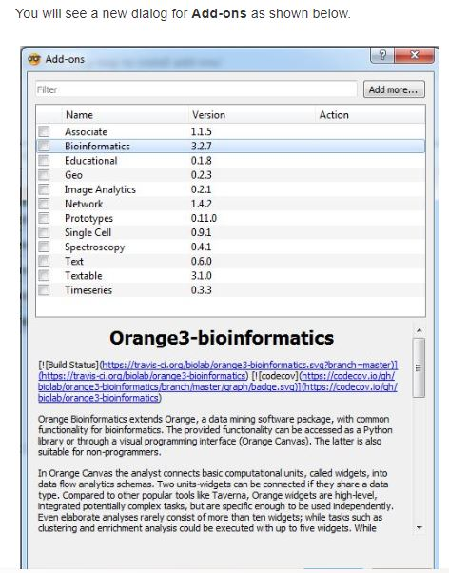

Slide 15
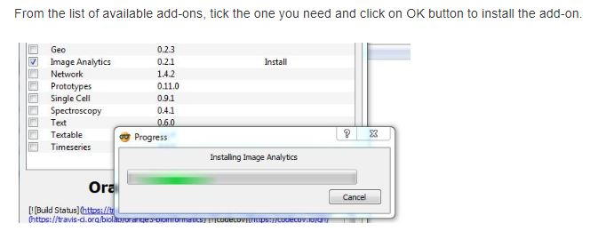

Slide 16
Lets see How Orange Works?
When You start Orange
You see a welcome screen
We can exit the welcome screen
Orange start with a blank canvas.
This is where all magic takes place
But every magic seeks some secret ingredients.

Slide 17
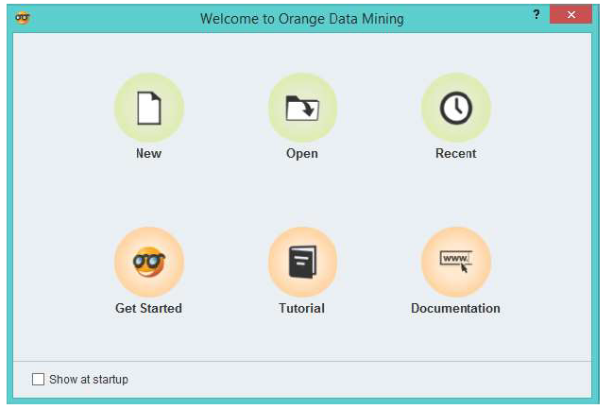
Getting Started with Orange

Slide 18
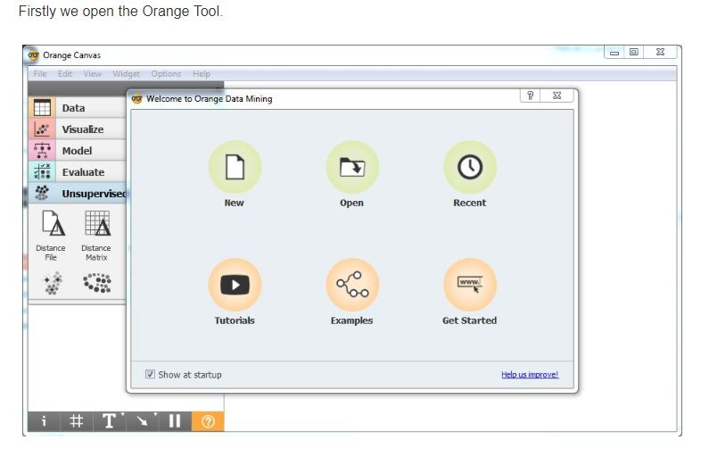

Slide 19
Widgets: Secret Ingredients of Orange
Computational units of orange
Reads the data, Process it, visualize it
Does Clustering
Build Predictive Models
These are on the LHS of Screen
Can do a number of actions based on what you choose in your widget selector

Slide 20
File Widget
Most data analysis occur with file Widget
Click on file widget.
It will appear in the canvas
Double click on file
Select any of the existing dataset.
Orange itself has many existing dataset in its repository.
You can load your dataset
But for simplicity, we will start with heart disease dataset.

Slide 21
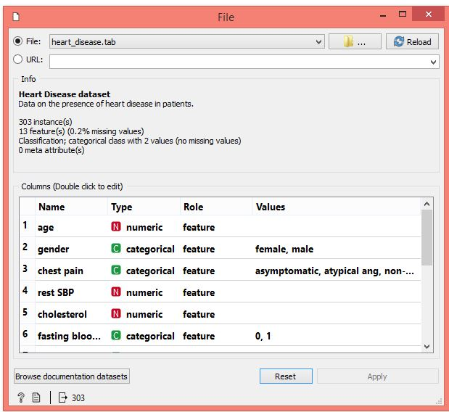

Slide 22
Heart Disease Dataset
Open the heart disease dataset in the orange directory
Click on data table icon. It will appear in canvas
On double click of data table icon, it will give details of heart disease dataset.
Widgets communicate with each other.
They have an input channel, output channel or both.
Draw a link connecting from file to data table

Slide 23
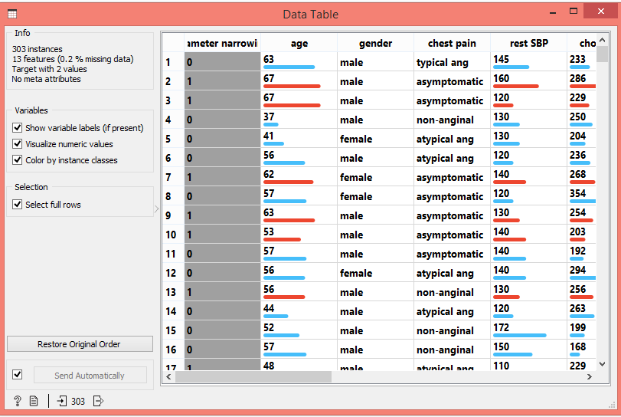
On opening the data table, there are number of rows and columns

Slide 24
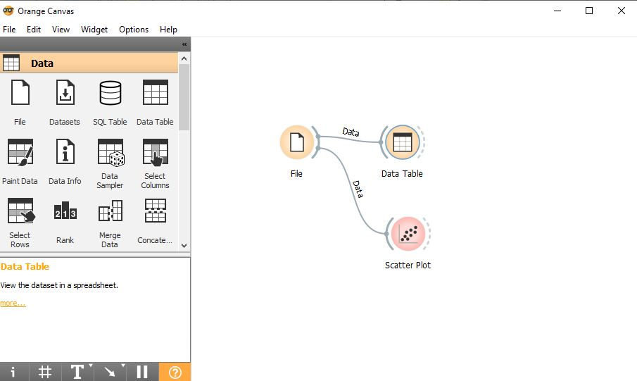
Lets plot the data, we will use scatter plot and connect with file widget (See 1st Workflow below)

Slide 25
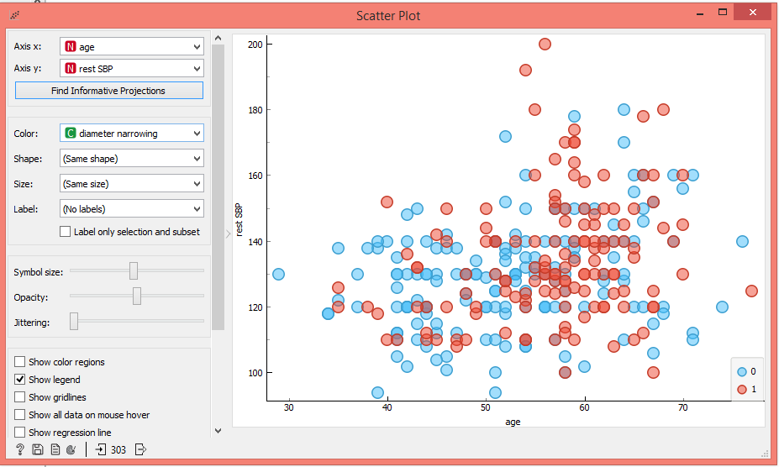
Scatter Plot

Slide 26
Types of Plot Created in Orange
Box Plot
Sieve Diagram
Scatter Plot
Dendogram
Distribution plot
Nomogram
Heat Map
Depending upon the requirement in your research work, you can select the type of plot suitable for your data.
This will give you graphical distribution of your dataset.
Create significant impact when you add such unique plots in your research paper or thesis report.

Slide 27
Creating Data Workflows in Orange
We start opening the data in file widget
Simply load heart disease dataset
Select data table widget
Dataset has 303 samples of male and females.
Heart is described by 13 features like blood pressure, cholesterol, chest pain, etc
Connect File to distribution widget

Slide 28
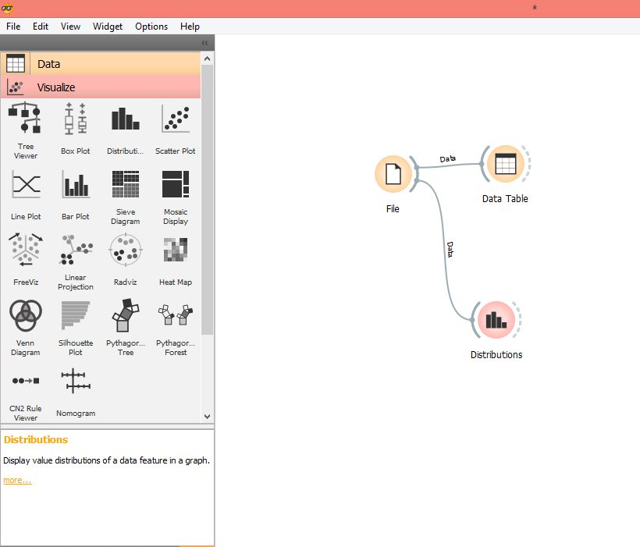

Slide 29
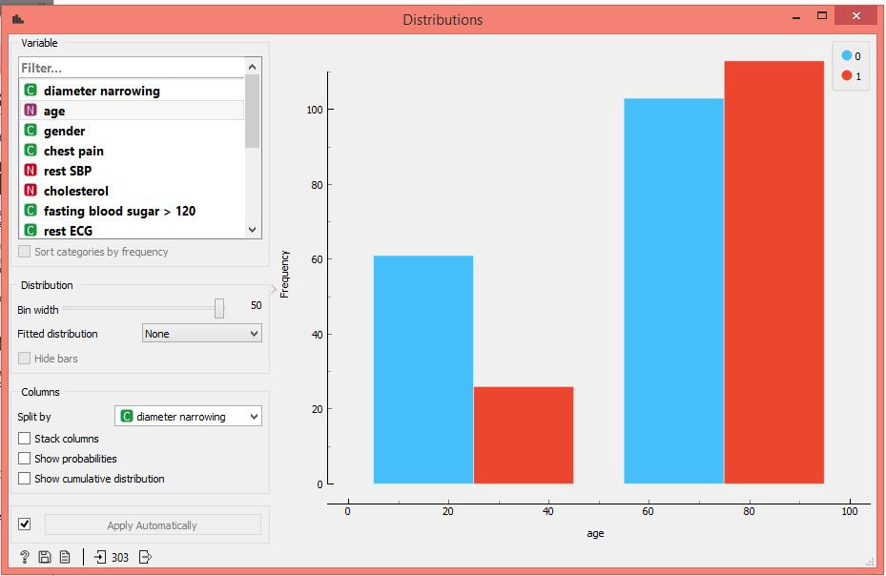
In distribution widget, one can walk through all the features in data.

Slide 30
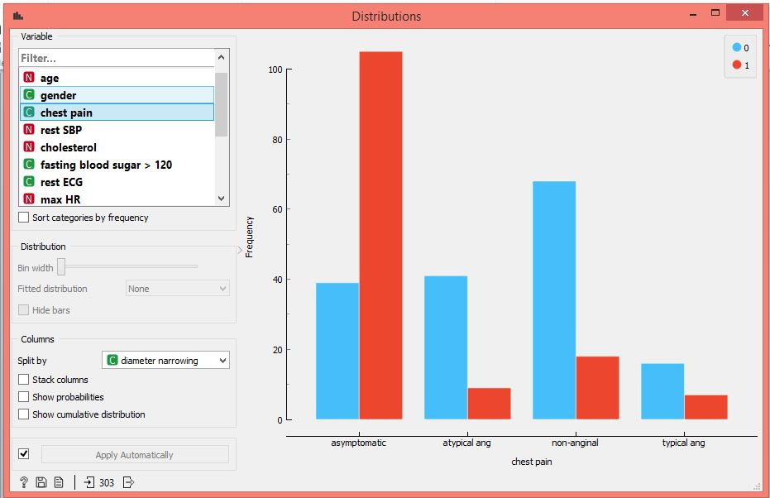
Chest pain distribution
Chest pain

Slide 31
See Scatter Plot again of same dataset

Slide 32
When we visualize scatter plot, its bit messy
Classes are not well separate.
One can select the overlapping classes.
We can plot one another plot from new selected data.
This will clearly distinguish one class from another.

Slide 33
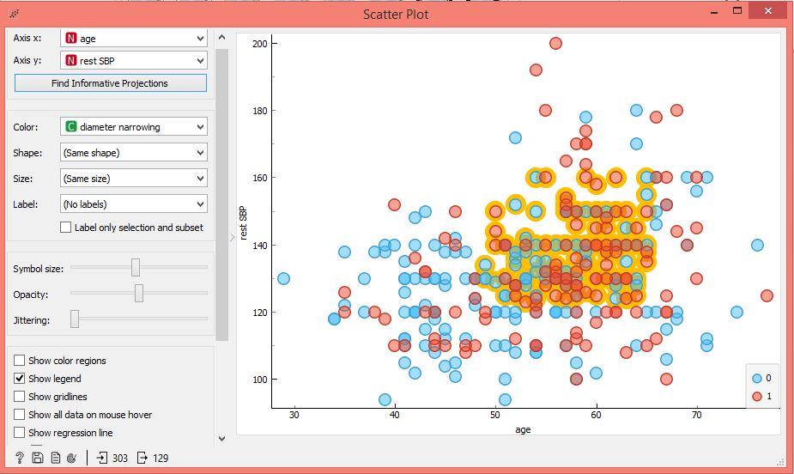

Slide 34
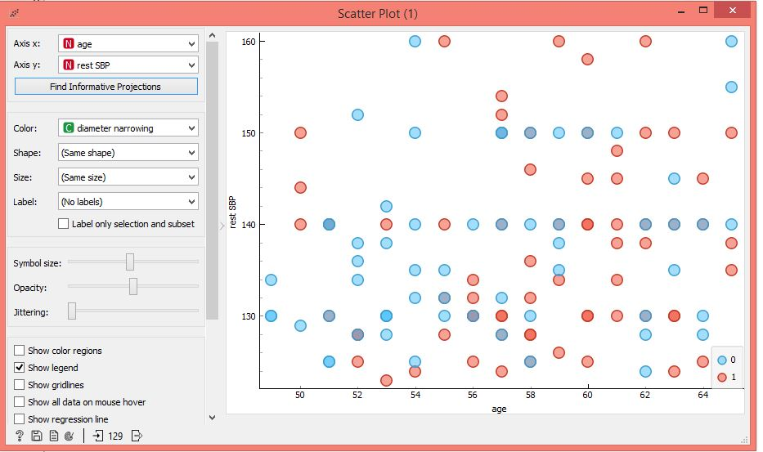

Slide 35
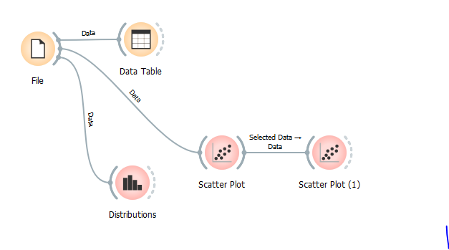
Changes in one widget are immediately propagated through workflow

Slide 36
Methods to add Widgets in Orange
In Orange, you can select widget in many ways
Click on widget in widget pane and it will appear in canvas.
Drag and drop exactly in canvas
Right click on canvas and select widget from their or type its name
Drag a communication channel from output of file widget and orange will suggest the widget u can connect to original widget.
Orange will not allow you to connect
incompatible widgets.

Slide 37
To get more space, i.e Bigger canvas
Click on View in menu button
Deselect Expand tool deck
Canvas size will increase

Slide 38
You can also tell orange what kind of data can be send from one widget to another
Lets use same heart dataset again
I will first connect scatter plot and data table to the file widget.
Lets see if the data was received by scatter plot.

Slide 39
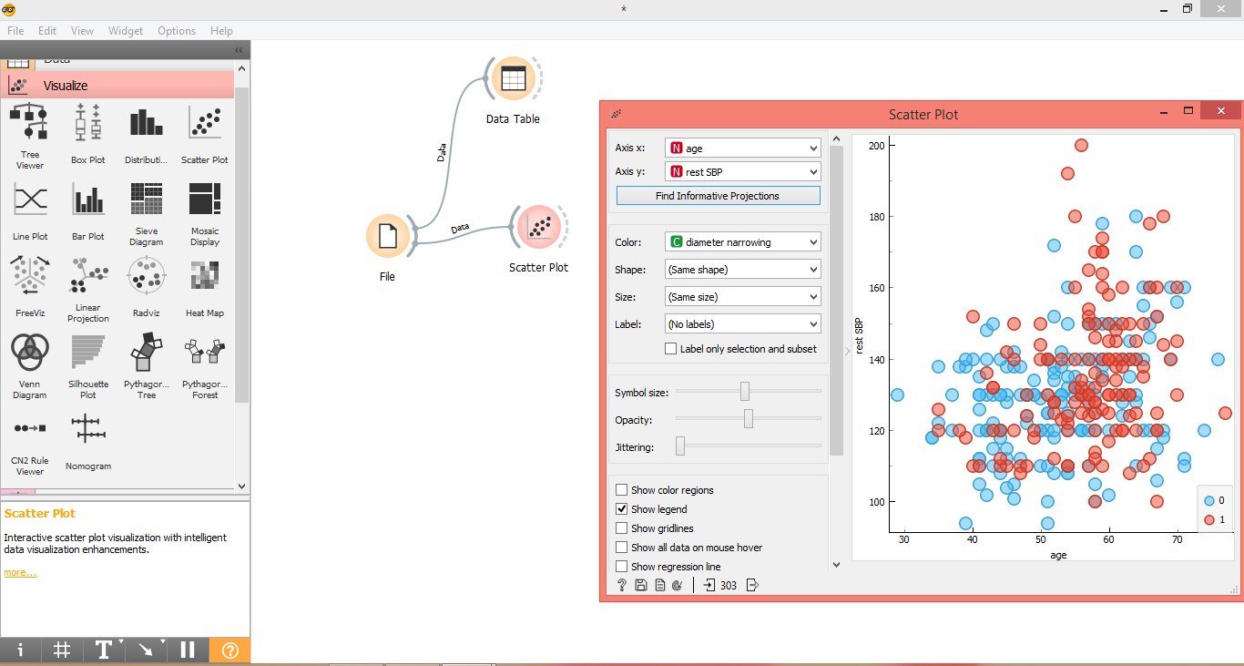

Slide 40
Now connect data table with scatter plot.
Idea is that I will select data some instances in data table.
These instances will be highlighted in scatter plot.
Open the data table and select some instances
Widget will send the selected instances straight to scatter plot

Slide 41
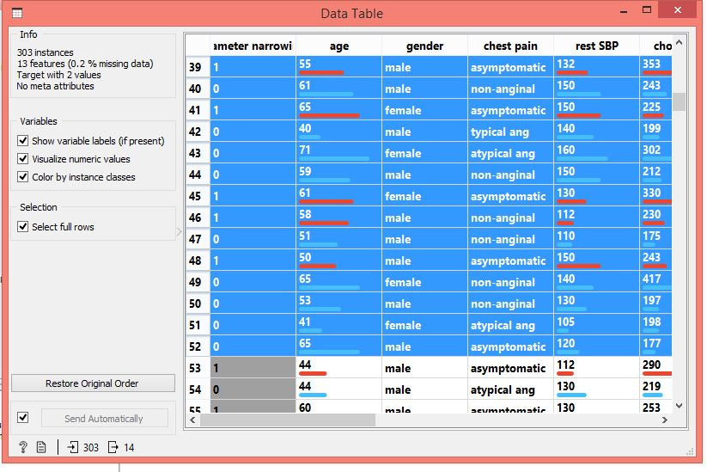
See highlighted instances in data table

Slide 42
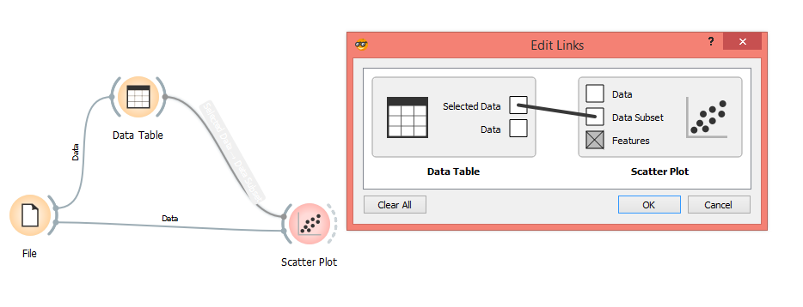
We have just created a visual browser.
Double click on link between data table and scatter plot.
Orange correctly guess that data from data table will be used as data subset in scatter plot.

Slide 43
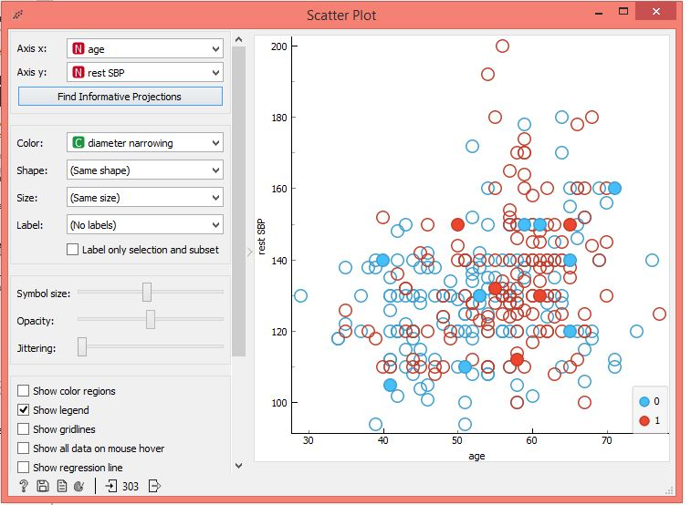
Dark Red instances shows selected instances

Slide 44
Loading and Saving your Data
Most important task
Orange supports various data formats: xls, tab and .CSV.
Data is a table where data instances are in rows and data attributes are in column

Slide 45
Magic in Orange
Create Dataset from any Graph you want
Most wonderful feature of Orange is that you can do reverse process.
In general we have seen that we plot a graph from the data the we have, but here the reverse is also possible!
It seems strange but yes it is true that you can paint your graph by using paint data functionality
You will be able to generate the dataset for that graph which you have painted using paint data utility of Orange.

Slide 46
Using Paint Data Widget, with help of brush we have painted the graph which we want.
So this is just like a miracle for most of the researchers who are not getting dataset as per their requirement.
They can now simply get the dataset as per their requirement with just one click.

Slide 47
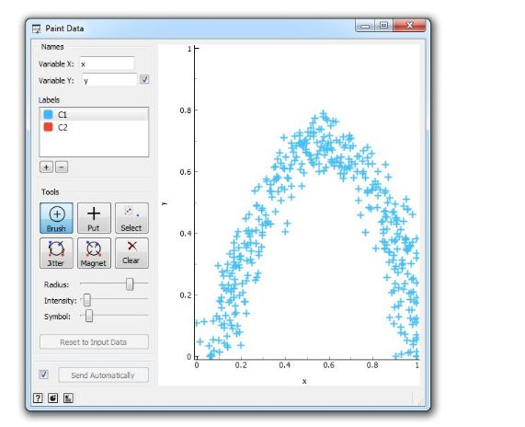

Slide 48
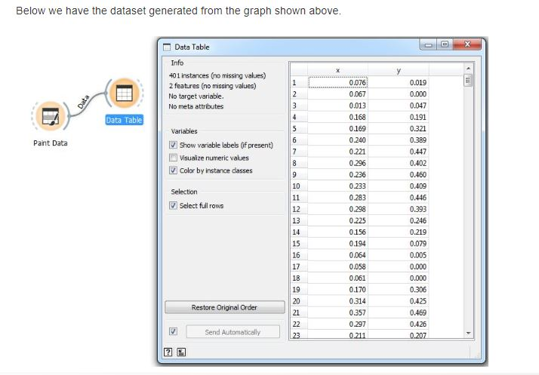

Slide 49
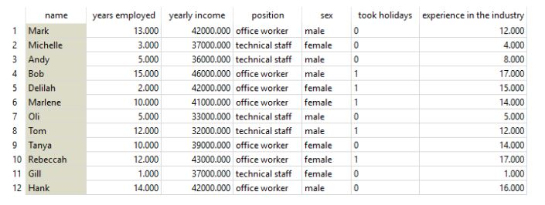
Widgets useful in Research
Preprocess: is there to handle a big share of your preprocessing tasks.

Slide 50
It can normalize numerical data variables.
Assume we have a fictional data set of people employed in your company.
We want to know which employees are more likely to go on holiday, based on the yearly income, years employed in your company and total years of experience in the industry.
If you plot this in heat map, you would see a bold yellow line at ‘yearly income’.
This obviously happens because yearly income has much higher values than years of experience or years employed by your company.

Slide 51
You would naturally like the wage not to overweight the rest of the feature set.
Normalization is the way to go.
Normalization will transform your values to relative terms, that is, say (depending on the type of normalization) on a scale from 0 to 1.
Heat Map neatly shows that people who’ve been employed longer and have a higher wage more often go on holidays.
(Yes, this is a totally fictional data set, but you see the point.)

Slide 52
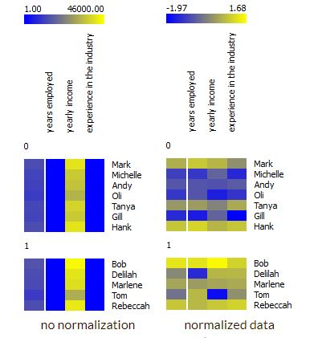

Slide 53
It can impute missing values.
Average or most frequent missing value imputation might seem as overly simple, but it actually works most of the time.
Also, all the learners that require imputation do it implicitly, so the user doesn’t have to configure yet another widget for that.

Slide 54
Preprocessing needs to be used with caution and understanding of your data to avoid losing important information or, worse, over fitting the model.
A good example is a case of paramedics, who usually don’t record pulse if it is normal.
Missing values here thus cannot be imputed by an average value or random number, but as a distinct value (normal pulse).
Domain knowledge is always crucial for data preparation.

Slide 55
Image Processing through orange

Slide 56
Transforming images into numbers
When we do any research work say in image processing or bioinformatics.
We have to deal with some data
Data can come in all shapes and sizes
Can be a simple spreadsheet or text.
Can be audio, video or an image
First You have to install IMAGE ANALYTICS WIDGET (By default its not available)

Slide 57
Lets Start with an example
For some experiment we need some raw images when we apply machine learning in image analysis.
I have collected some images of domestic animals and saved on my desktop in 1 folder.
Link for the image files: https://github.com/ajdapretnar/datasets/blob/master/images/domestic-animals.zip

Slide 58
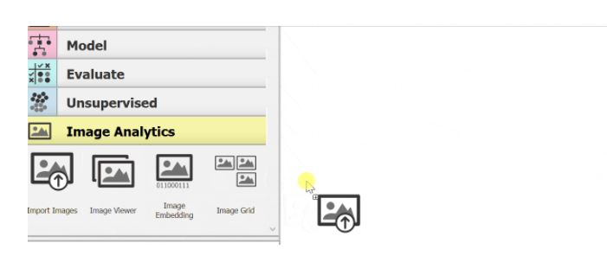
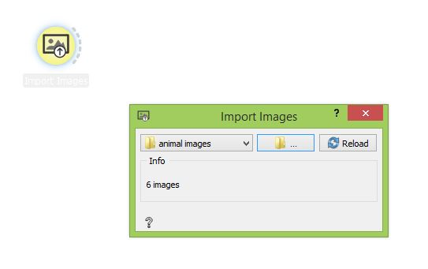
Import Images
The first thing to do is to import the image via the Import Images widget.
You can think this widget as the File widget for image. However, Import Images widget accepts a directory instead of a file.

Slide 59
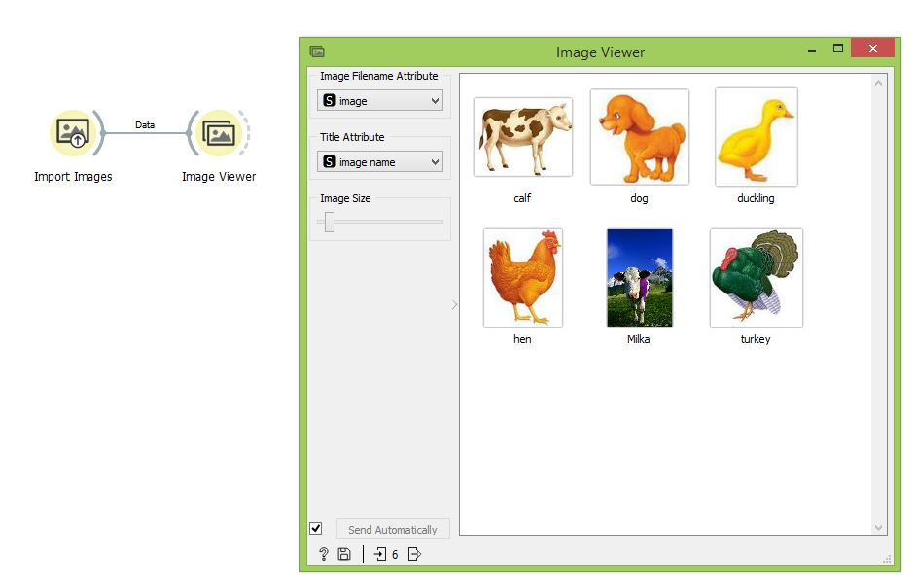
Now Connect Image viewer widget to import images.
We have all the 6 animals here.
https://github.com/ajdapretnar/datasets/blob/master/images/domestic-animals.zip
Import Image actually constructs and outputs a data table.

Slide 60
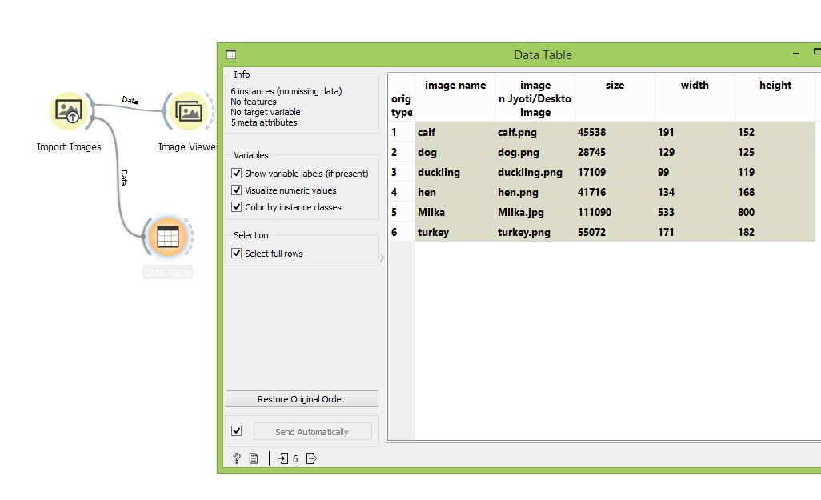
How this data look like
Lets check this in data table widget
All we have is a bunch of meta information
Image name, image path, image size
Just like we have a MATLAB function WHOS

Slide 61
Things are not easy as it seems
But what do we see in a data table?
Only some useless description of images (file name, the location of the file, its size, and the image width and height).
The data we retrieved will not help us in data optimization and classification.
We need image descriptors
That is numbers which describe the contents of these images.
We will transform raw images into their vector representation using Deep Neural Network.

Slide 62
NN was trained on millions of real life images.
Retrieved vectors are also called image embedding.
We will embed our images into a multi dimensional feature space.
To acquire numerical representation of these images, we will send the images to Image Embedding widget.
Connect import images to image embedding

Slide 63
Image Embedding
For your information, classification and regressions tasks requires data in the form of numbers.
There isn’t a good way to perform such tasks with images unless we represent it in the form of numbers.
Image Embedding widget works by converting it to a vectors of numbers.
Image Embedding widget reads images and uploads them to a remote server or evaluate them locally.

Slide 64
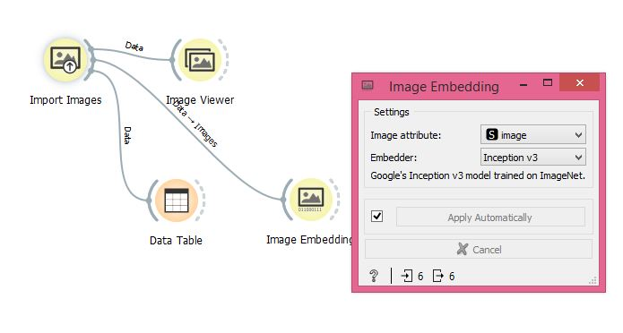
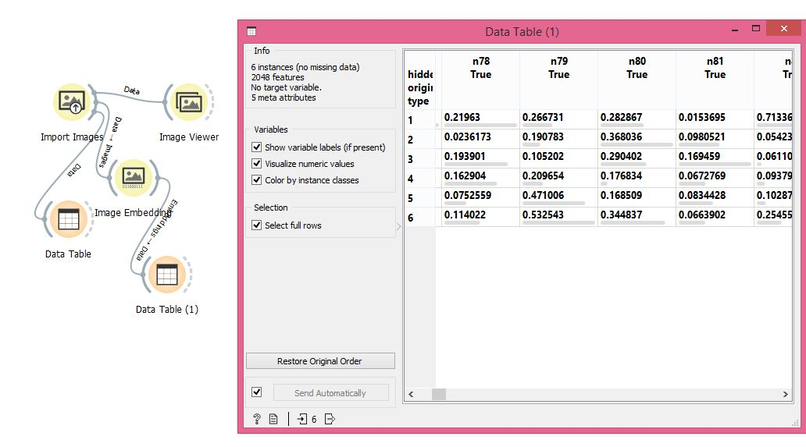

Slide 65
Earlier we have only meta data
Now we don’t only have meta data rather additional 2048 features to profile the images
This is what we called feature extraction in Machine learning.
With embedding widget we can compare the images and compute their similarity.
Lets pass this data to another widget DISTANCE as it usually work best for the images
Then we can pass the distance matrix to Hierarchical clustering and observe another plot called dendogram

Slide 66
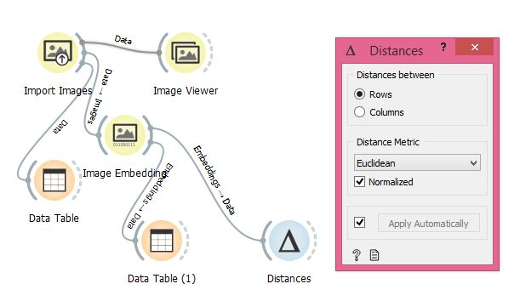
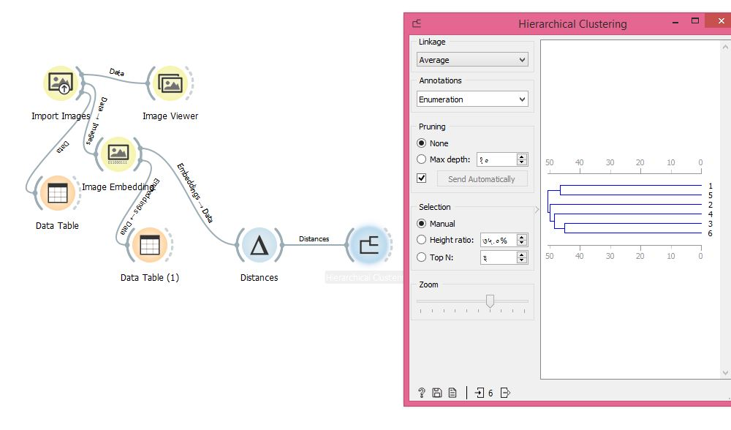

Slide 67
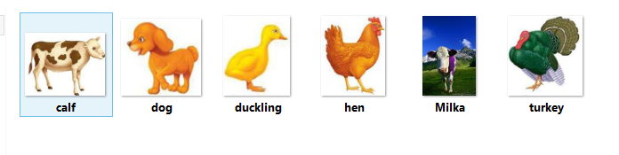
1 and 5 are clubbed together, Both Cows
2 and 4 are clubbed together, Dog and hens (Some Similarity)
3 and 5 are clubbed together, Ducks and Turkey

Slide 68
Image analytics is such an exciting field in data optimization and now Orange is a part of it too!
You need to install the Image Analytics add on and you are all set for your research!

Slide 69
Image Classification for Architecture Distortion in Mammograms
We will take the example of Breast Cancer database, DDSM for the purpose of classification.
Digital Database for Screening Mammography
We have 2 set of images of Architecture Distortion (AD)
Benign and malignant samples.
In AD, the surrounding tissues appears to be pulled inward.
No definite mass visible.
Focal retraction.
Distorts the normal oriented texture.

Slide 70
I have created 1 folder mammograms with 2 sub folder of 10 images each of benign, malignant cases of mammograms.
Let us slow the main folder mammograms with import images
Each subfolder is considered by an orange as an image class label
We uploaded 20 images belonging to the 2 classes.
Let us observe result in the image

Slide 71
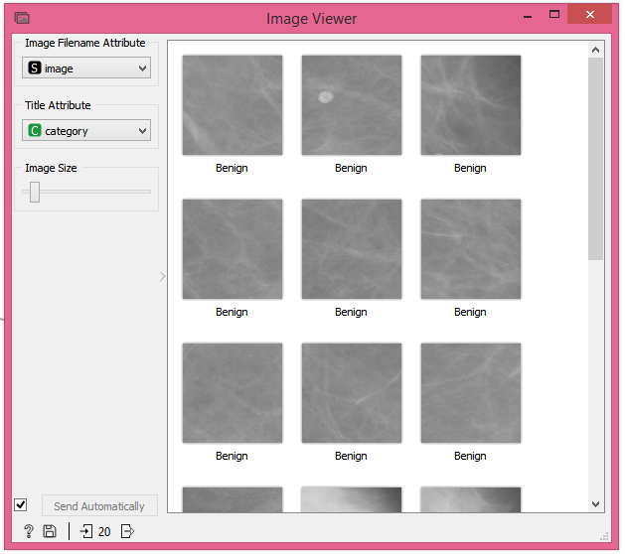

Slide 72
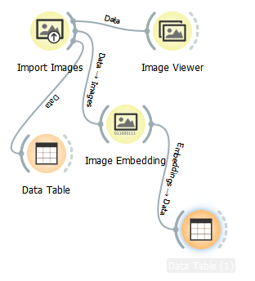
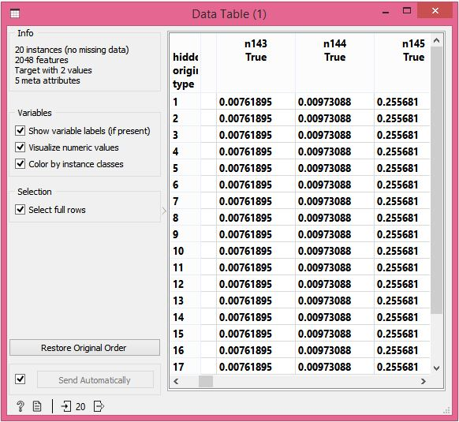

Slide 73
By creating workflow and applying image embedding widget we get meta information from benign and malignant samples of mammogram
Each image is described with 2048 additional features from deep network embedding of 20 mammogram samples.
We will use cross validation to check how well we can predict the type of mammogram.
We can apply Test and score widget with image embedding widget

Slide 74
Test and score cross validation also requires a learner
Ada Boost Classifier is a good choice for this problem.
Connect Logistic regression widget to test and score widget.
Test and score performs 10 fold cross validation on images and reports on accuracy, area under curve etc.

Slide 75
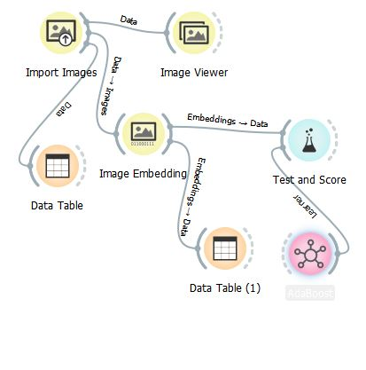
Workflow

Slide 76
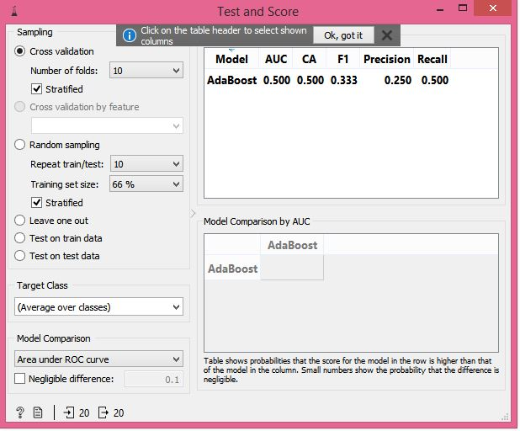
Though Results are just 50% as we took a small database for your understanding.

Slide 77
This concludes this problem
In image processing algorithms, the main task is to apply your proposed algorithm to get the enhanced images.
Further the enhanced ROI are optimized for feature extraction and further classification
You must be having in-depth knowledge about the type of classifier to be sued pertaining to the type of research problem.

Slide 78
Clustering of Monet and Manet
For me it was always hard to tell the difference between 2 painters, Monet and Manet.
We all are not an artistorian, but we all know how to work on data, thus we can solve this problem with orange.
Let us load 27 paintings.
15 painted by Monet
12 Painted by Manet

Slide 79
For your assistance, the link to download such image is at http://file.biolab.si/images/
You can recognize how input image Widget Recognize the 2 sub folder.
Manet and Monet.
If we observe our data in the data table, we say the names in folder becomes our class variable.

Slide 80
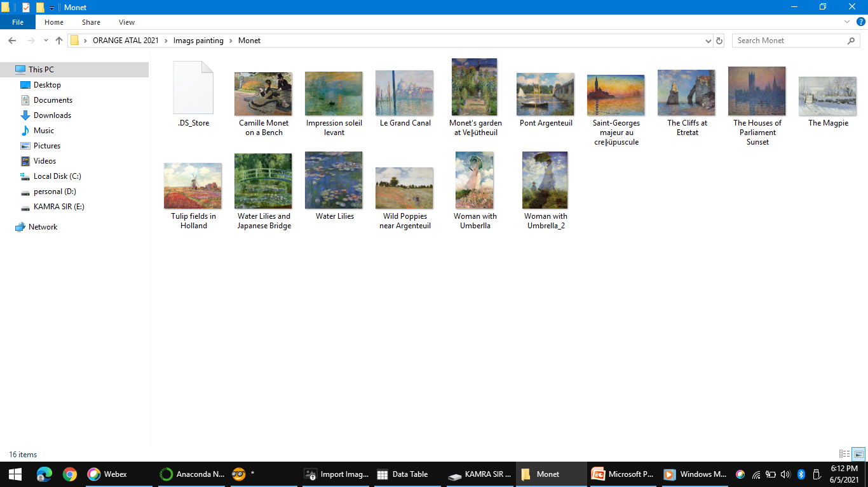
Monet Pics

Slide 81
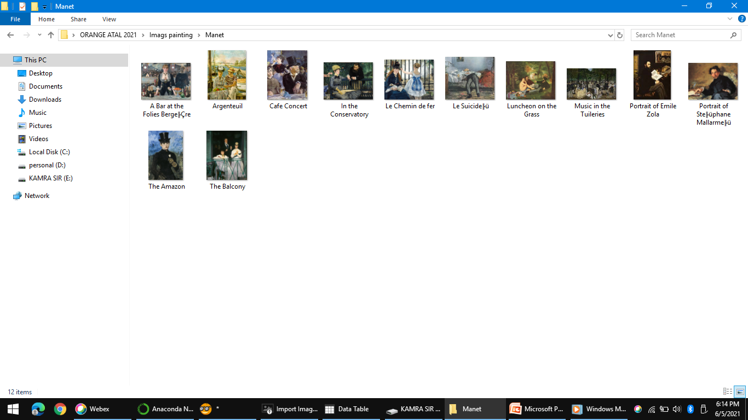
Manet Pics

Slide 82
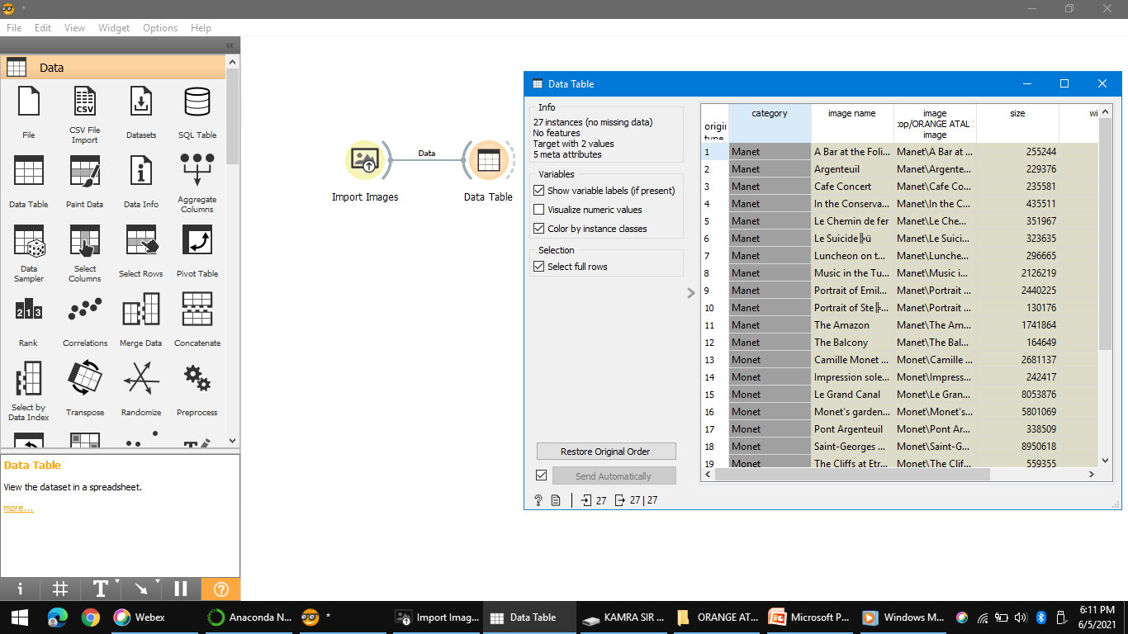

Slide 83
But as we have seen in our previous examples, we cannot work with image alone.
We need to transform them into their numerical representation.
We will use image embedding and choose the inceptionV3 embedded.
This embeeder was trained on large collection of images of real life and is able to recognize the motifs in the images.

Slide 84
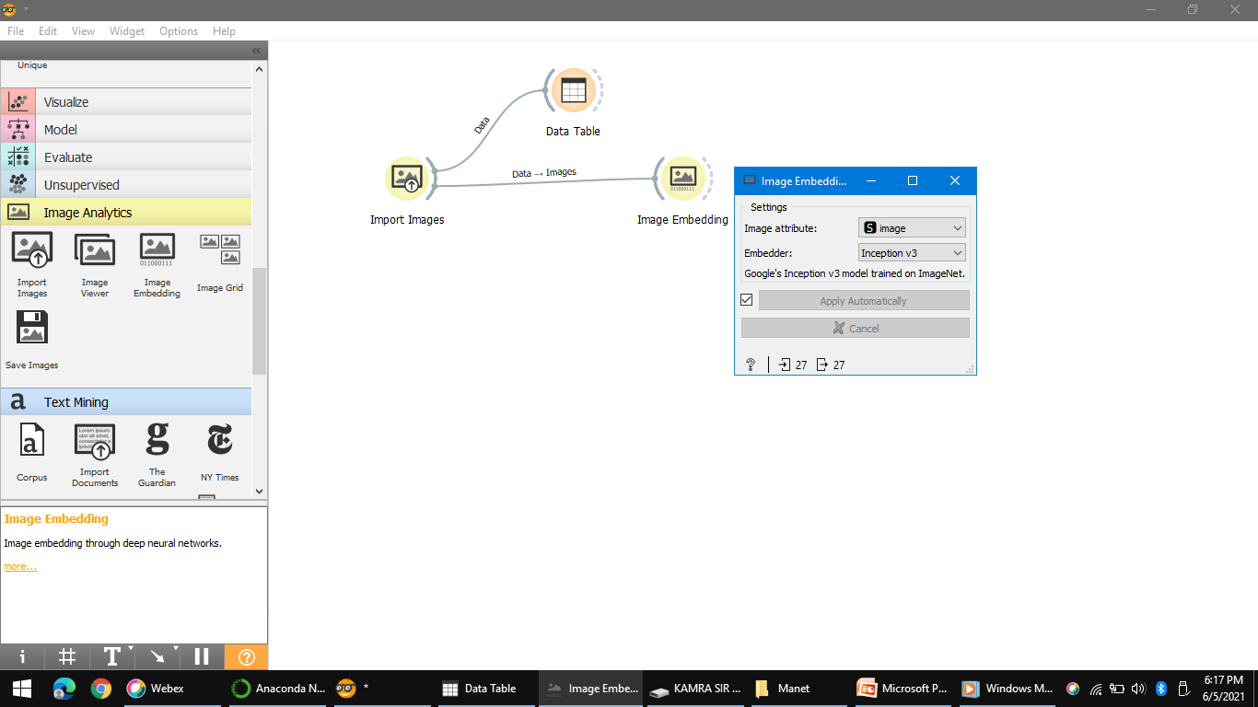

Slide 85
This means we can find out whether the 2 painter painted similar or different motifs.
MOTIF is a recurring narrative element with symbolic significance.
We will measure the similarity between feature profile of our paintings with distances.
But set the distance measures as COSINE
COSINE distance measure will only consider the relative presence of features and not its absolute value.

Slide 86
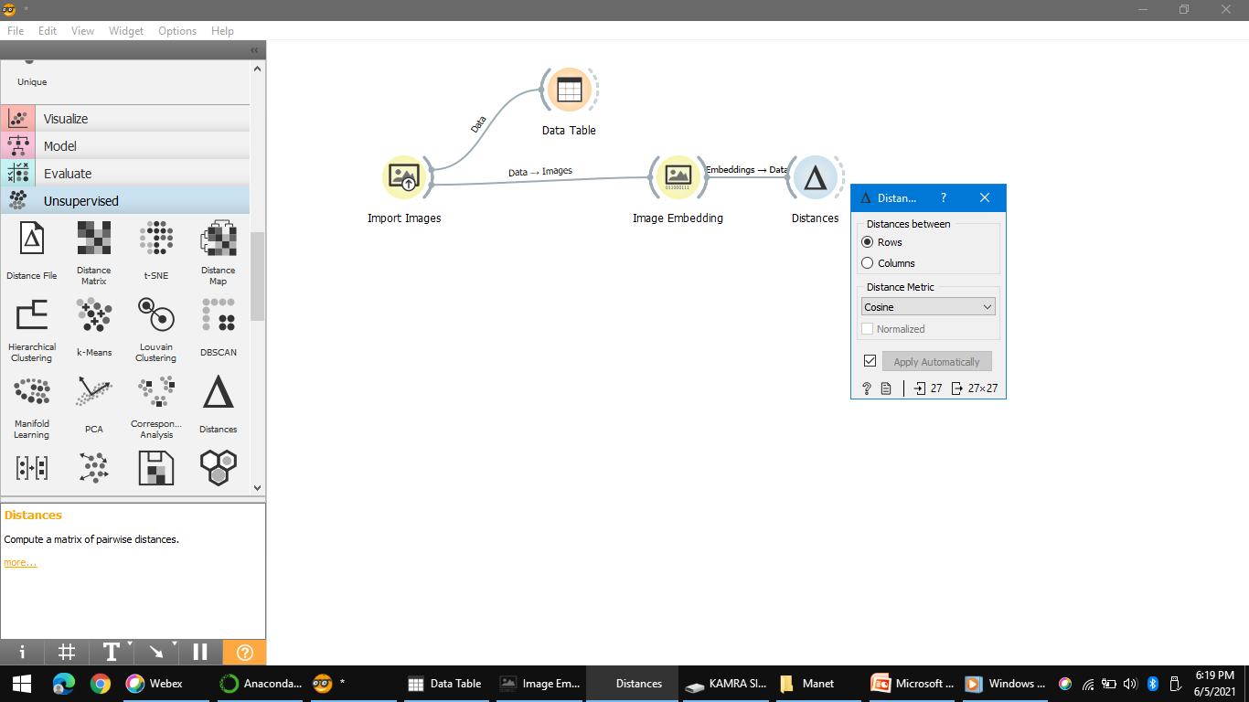

Slide 87
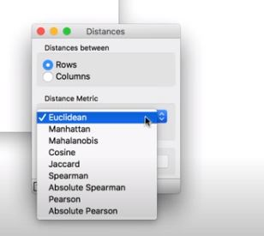

Slide 88
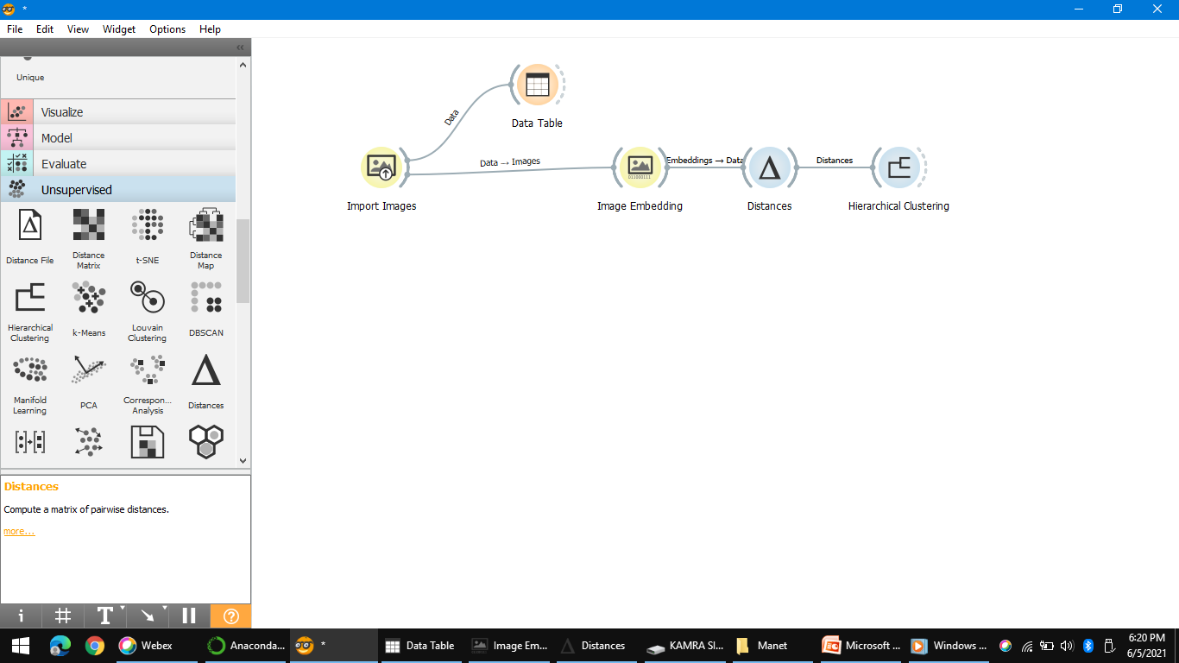

Slide 89
Finally send the computed distance matrix to hierarchal clustering.
You can see in the output that clustering independently discovered two groups that correspond to two painters.
But wait a minute have a close look up on the output

Slide 90
It made one mistake, their is a Monet’s painting that resembles similar to Manets master pieces.
Let us see that suspicious image and select the suspicious cluster and send it to image viewer set.
We can set the label to image name to name the paintings with their proper title looks.

Slide 91
Here Clustering didn't make a mistake.
All the images in MONET are very similar, they all portray a man and a lady with a hat with a women sitting on a bench.
One thing is very important here that computation of distances and hence clustering didn’t consider class labels yet clustering founds two clusters of similar images that corresponds nicely to our predefined labels.

Slide 92
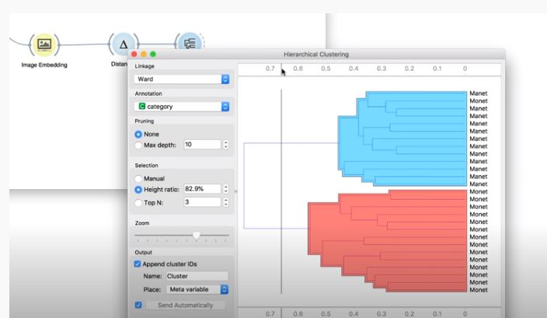

Slide 93
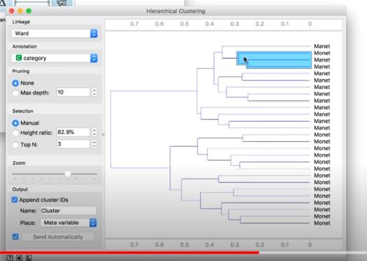

Slide 94
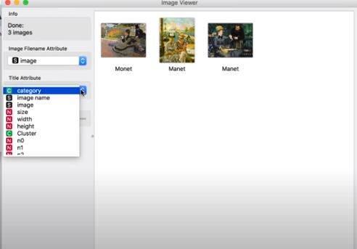

Slide 95
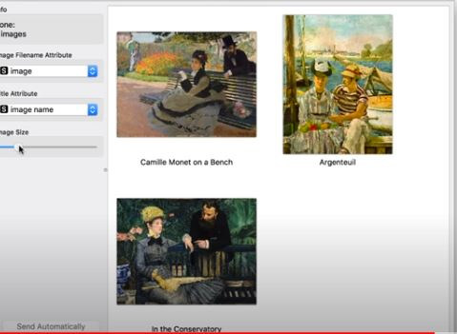

Slide 96
Covid 19
Explore the Covid-19 Data with Orange
Covid-19 is undoubtedly the news of the year.
Thousands of health workers are working tirelessly to help those who fall sick.
We engineers, data scientists are trying to explore the virus through data mining and machine learning.
Now we will see how anyone can take the covid data and explore it.

Slide 97
Let’s start by getting the data
Data set is provided by the John Hopkins University: https://github.com/CSSEGISandData/COVID-19.
Please note that this data is updated regularly, so your results will differ.
Copy paste this link in URL to directly fetch the covid-19 data from server
https://raw.githubusercontent.com/CSSEGISandData/COVID-19/master/csse_covid_19_data/csse_covid_19_time_series/time_series_covid19_confirmed_global.csv

Slide 98
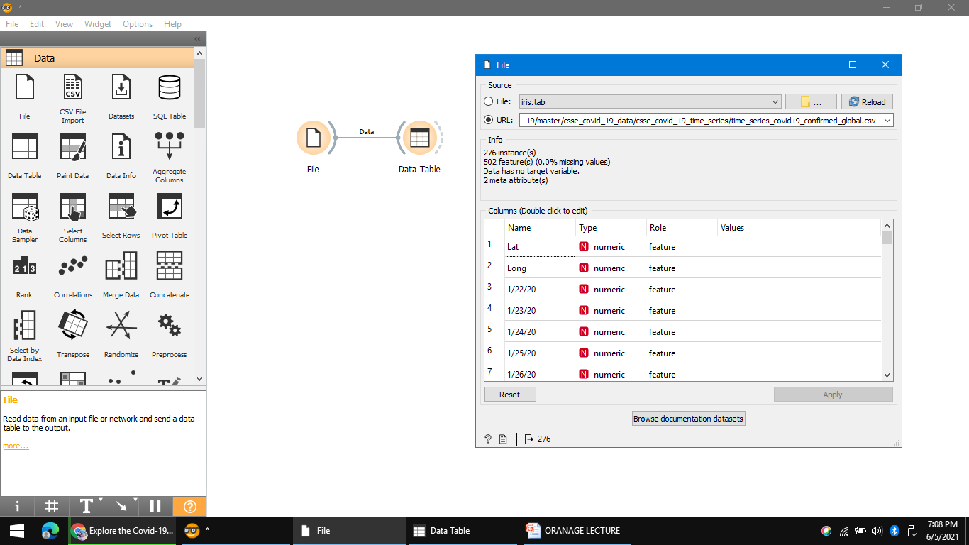

Slide 99


Slide 100


Slide 101


Slide 102
Line plot is the perfect visualization for sequential data such as that of covid 19 in give url.
Curves represent the countries and x axis represents date.
But from this plot we can see anything really concrete as there are many countries and many of the lines are thin.
Let us select a few lines by dragging across them and inspect them in data table
Some of countries selected are South africa, UK, Pakistan, spain and so on.

Slide 103


Slide 104
We all know which were countries with highest Covid patients in 2020 and 2021.
But here we can dig bit little deeper.
Orange comes with a handy data set widget which by chance happen to have an HDI data set (Human Development Index).
HDI is a data set with country statistics.
So let us add this to COVID data.
Place dataset on the CANVAS.
Load HDI and use merge data to merge the 2 datasets.

Slide 105


Slide 106


Slide 107
Data table shows that there are some countries with missing HDI.
These were likely not matched properly since their country names differ in 2 datasets.
To fix this, we will use Edit domain and insert it between datasets and merge data.
We first transform the country variable from string to categorical which enable us to edit the country names in the data table.
In the data table before we saw that United states was not matched correctly, double click it and change to name US.
Similarly you can find other countries name and change their names too.

Slide 108


Slide 109


Slide 110


Slide 111
Press apply, once you have finished editing the data.
Now we are able to bring in such a data as population and number of doctors per million.
Let us construct a pipeline that will tell us how many Covid patients are their relative to entire population.
First we will remove the countries with unknown population.
We will connect select rows to merge data and set total population to be greater than 0.
This will come in handy in next step where we will be using feature constructor widget to compute the cases to population ratio.

Slide 112


Slide 113


Slide 114
I will select the final data from covid dataset.
Here I choose any random date say 17/5/2021.
Then we will divide it by total population from select feature button.
We remove zero population in the previous step to avoid dividing by zero.
Now connect scatter plot with feature constructor widget.
Select cases per million in x axis and physicians for the Y axis.

Slide 115


Slide 116


Slide 117
The output last slide shows how covid spread is related to number of doctors in country.
Apparently Burma and China on 17/5/2021 has low number of covid cases with high number of doctors.
It means their health care system is in good position to handle the crisis.
Unluckily India along with Colombia and Greece is at bottom which shows these have worst cases to doctors ratio.

Slide 118
We don’t have any idea about oxygen concentrators, respirators, protective equipment.
This work flow is just an approximation of health care system capability.
One can change the x axis and y axis in scatter plot and can get more interesting results that can assist in better analysis of covid 19 and other parameters in given table (from URL).

Slide 119
GEO and Time series tool box
Visualizing COVID-19 data with MAPS
In orange, with the help of time series tool box, one can plot information about covid on actual map.
For this purpose we need orange add ons GEO and time series which you can install from options add on.
Consider the covid data given in URL again

Slide 120


Slide 121
We have information on the country latitude and longitude of every country.
We will use geo map widget to plot data points.
Latitude and Longitude are automatically selected.
What we can do better is by selecting the particular date for the number of cases on that day.

Slide 122


Slide 123


Slide 124
Text Processing
We have worked on excel files and images.
How about Text ?
Could we extract some meaningful information from a set of documents.
We need to install Text add on.
Lets us load the data,
Place the corpus widget on canvas and open it.
Go to Browse documentation corpora.
Load Grimm-tales-selected.

Slide 125


Slide 126
This tab has 44 tales on the O/P of widget.
What are these text about ?
Connect corpus viewer to corpus.
Corpus viewer displays text and enables us to browse it.
For example, we can output only those documents that contain word king.

Slide 127


Slide 128
Another widget for visualizing text is Word Cloud.
This widget displays word frequencies in cloud.
More frequently the word appear in the text the larger the word will be.
But word cloud shows lot of silly things like punctuation and un-informative words.
Next step is to use preprocess widget to get rid of these things. It will transform all the text into lower case.

Slide 129


Slide 130


Slide 131


Slide 132
Preprocess widget will convert text into individual words and omit the punctuation.
The effect of preprocessing can be visually explored in word cloud.
After preprocessing, the visualization looks much better.
We retained only meaningful words and now we can better understand what our corpus is about.
Preprocessing is first an very important step in text mining.
We define our tokens and filter out the bits we didn’t required.

Slide 133
Text Clustering
Now we have done preprocessing of data.
Is our data is ready for Machine Learning: Not quite.
After preprocessing orange still sees only lines of text.
For Machine learning we need to transform text into numerical representation.
Simple way to do is to count how many times each word appears in the text.
This approach is called bag of words.

Slide 134
Lets Create work flow
Corpus read the collection of text documents.
Text processing removes stop words and delimiters.
Now we will extend the workflow with a bag of words widget.
Bag of words output the data table where word counts are the new added features.
One can always check the output of bag of words in a data table.

Slide 135


Slide 136
Now we have our data matrix
We can find interesting groups of documents.
Connect Distances to Bag of Words.
Here, we will use cosine distance as it normally works best for corpora.
We feed computed distances to Hierarchical Clustering.
To estimate the distances between clusters we will select Ward linkage.
Now drag a line at the top of the visualization left and right.
What is the appropriate number of groups?
I think two seems to make the most sense.

Slide 137


Slide 138


Slide 139


Slide 140
The nodes in our dendrogram also have a label.
If the tale talks about animals, it's an animal tale.
If it's more about dragons and princesses, it's a tale of magic.
Looks like the tale type corresponds quite well with our clusters.
Except for one part where animal tales and tales of magic are mixed.
Can we figure out why they're mixed?

Slide 141


Slide 142
Select the cluster
Connect Corpus Viewer to Hierarchical Clustering.
Seem like some tales of magic still mention animals.
Perhaps clustering got it right after all.
Clustering is a great way to uncover similar documents in unlabeled text.

Slide 143


Slide 144
Text Classification
We already know how to preprocess our corpus
And how to find similar documents with hierarchical clustering.
But Grimm's tales also have a label.
Tales are either animal tales or tales of magic.
Can we use these data to predict the type of a new, unclassified tale?

Slide 145
We read grimm-tales-selected
Check the data in Corpus Viewer.
We prepare the text with preprocessing and turn it into a bag of words, which represents each tale with a vector of word counts.
Now for the classification.
Connect Logistic Regression to Bag Of Words.
Connect it to Logistic Regression.
The widget displays top ten words that are important for the classifier.

Slide 146


Slide 147
Logistic regression constructs the model to predict
whether a tale is an animal tale or a tale of magic.
We can even see how our model looks like-
We will use Nomogram
which visualizes the logistic regression classifier.

Slide 148


Slide 149
At the top of the list are the words that most contribute to the prediction.
Seems like the word 'fox' can tell us a lot about the tale.
If 'fox' appears often in the text, it's an animal tale.
If it doesn't, it's probably a tale of magic.
Now we know how our classifier works, and it's time to see if it also performs well.

Slide 150
Connect Test and Score to Bag of Words.
We will use Test and Score
to cross-validate the logistic regression model.
Not bad!
The area under the ROC curve is over 0.97.

Slide 151


Slide 152


Slide 153
When given two tales of a different class, logistic regression can correctly distinguish between them in over 90% of the cases.
But we said we want to predict the tale type, right?
And we don't want to predict something we already know.
We will place a new Corpus widget on the canvas.
Let us load three new tales from Hans Christian Andersen.
We will ask our logistic regression model to tell us what are the types of these new tales.

Slide 154
Connect Corpus (1) to Predictions.
Now, provide the Grimm-trained logistic regression model and observe the results in Predictions.
Our model says The Ugly Duckling is an animal tale and The Little Match Seller a tale of magic.
Seems quite right.

Slide 155


Slide 156


Slide 157
Predicted class probabilities were high as well.
The probability that The Ugly Duckling is an animal tale is 90%.
Today we've learned how to inspect our logistic regression model with nomogram,
How to re-use the familiar classification workflow on text.
How to predict the type of the tale on new corpus.
This concludes the problem.

Slide 158
BASIC EXPERIMENTAL SET UP FOR
COMMON CLASSIFIERS

Slide 159


Slide 160


Slide 161


Slide 162


Slide 163


Slide 164


Slide 165


Slide 166


Slide 167


Slide 168


Slide 169


Slide 170


Slide 171


Slide 172
M.Tech. Level Project
Comparative Analysis of various types of classifier

Slide 173


Slide 174
Assignment for you
Image classification using Orange - Prediction of Pneumonia from Chest X-Ray
Problem statement here is classifying or diagnosing a patient is having pneumonia or not based on the chest x-ray images.
Load the types of images
Classify it into normal and abnormal categories
Create basis workflow
Choose prediction model and cross validation
Predict the accuracy and AUC

Slide 175
Dataset in excel form
https://github.com/nikicc/orange/tree/master/Orange/datasets
https://github.com/ajdapretnar/datasets/blob/master/images/domestic-animals.zip

Slide 176
Take away for Home
Introduction to Orange
Types of Widgets
Types of Graphs
Widget in orange for image classification
Tool is very handy for Faculty members teaching ML/DM/Python UG/PG Level.
Basic Machine Learning Optimization
Add on like Image Analytics/Text Mining/Geo/Time series.
Thanks for Listening

Slide 177
References
https://orangedatamining.com
Biolabs.com

